Slide 1
Collision Resistant Hash Functions

Slide 2
Hash Functions
Traditionally, hash functions take arbitrary length strings and compress them into shorter strings
Classically used in data structures for improved look-up times in storage/retrieval
Collisions for the hash function H are distinct inputs x and y such that H(x) = H(y)
Notes:
Every hash function with more inputs than outputs will necessarily have collisions.
In a more simple way, Collision resistance means that it should be hard to find two different messages m1 and m2 such that hash(m1) = hash(m2). Such a pair is called a (cryptographic) hash collision, and this property is sometimes referred to as strong collision resistance.

Slide 3
An Example
23
54
63
Number to be hashed
1
2
3
4
54 hashed to index 4.
Notes:
Here we need to add these elements into our hash-table.

Slide 4
An Example
23
54
63
Number to be hashed
2
3
4 (54)
1
23 hashed to index 3.

Slide 5
An Example
23
54
63
Number to be hashed
1
2
3 (23)
4 (54)
63
Collision!

Slide 6
Collision Resistance
A function H is collision resistant if it is infeasible for any probabilistic polynomial-time algorithm to find a collision in H
We deal with a family of functions indexed by s, H^{s}(x) = H(s,x)
A hash function is a pair of algorithms (Gen, H) where Gen(1^{n}) outputs the index s (for choosing H^{s})
If H^{s} is defined only for inputs x of a certain length, we say it is a fixed length hash function

Slide 7
Defining Collision Resistant Hash Function
The output of Hash-game is 1 if and only if x ≠y and H^{s}(x) = H^{s}(y)
Hash-game
(Gen,H)
A hash function (Gen,H) is collision resistant if for all probabilistic polynomial time adversaries A:
Pr[Output of Hash-game = 1] ≤ negl(n)
1^{n}, s
Adversary
x,y

Slide 8
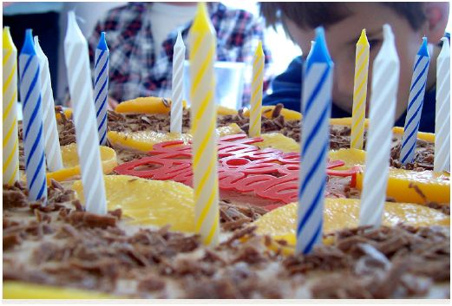
Birthday Attack
We can find a collision on a hash function by hashing random numbers until these hashed values have a collision

Slide 9
Relies on ‘Birthday Paradox’
Theorem: If we pick independent random numbers in [1,2,…,N] with uniform distribution θ√N times, we get at least one number twice with probability tending to
(1-e^{-(θ/2)*θ})
For N = 365 and θ = 1.2 we get prob ∼ 50%
Birthday Paradox: If there are 23 people,with probability at least ½ at least two of them have the same birthday
And for θ = 2.1 we get prob ∼ 90% !

Slide 10
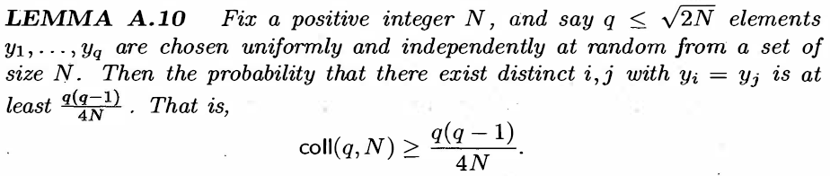
TEXTBOOK VERSION

Slide 11

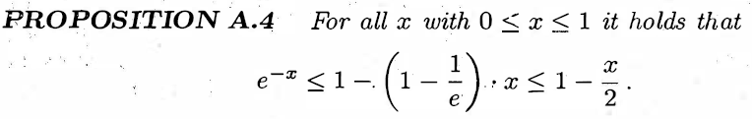
PROOF
NoColl_{i} : Denotes the event of NO COLLISION upto i

Slide 12
CONSTRUCTING COLLISION RESISTANT HASH FUNCTIONS
Step 1 (Merkle-Damgard): From Fixed Length Hash to Arbitrary Hash
Step 2: From DLP to fixed length Hashing

Slide 13
Merkle Damgard Transform
Constructing hash functions H^{s}(x) from fixed length hash functions (h^{s}) with inputs of length 2n and output length n
Message x
Length L <2^{n}
X₁
Length n
X₂
Length n
X_{L/d(n)+1}=L
Length n
Padded
Notes:
Let us build our knowledge so far and come up with a hash.

Slide 14
Merkle Damgard Transform
x₁
x₂
L = |x|
h^{s}
h^{s}
z₂
h^{s}
z₁
Z₀ = IV
H^{s}_{IV}(x)
Theorem: If (Gen,h) is a fixed length collision resistant hash function, then (Gen, H) is a collision resistant hash function

Slide 15
TEXTBOOK VERSION

Slide 16
SECURITY PROOF

Slide 17
BULIDING MACs USING HASHING
Keyed Hashing

Slide 18
HMAC: A Message Authentication Code
HMAC is the current industry standard as CBC-MAC is deemed to be slow
(Gen,h): A fixed length hash function
(Gen,H): Hash function after applying MD transform to (Gen,h)
Fixed constants: IV, opad and ipad
HMAC tag for m = H^{s}_{IV}( (k ⊕ opad) || H^{s}_{IV}( (k ⊕ ipad)|| m))
opad: 0x36 repeated as many times as needed
ipad: 0x5C repeated as many times as needed

Slide 19
HMAC Construction
_{k ⊕ ipad}
m₁
L = |m|
h^{s}
h^{s}
h^{s}
IV
_{k ⊕ opad}
h^{s}
h^{s}
IV
HMAC tag

Slide 20
Collision Resistant Hash Functions in Practice
Popular practical constructions
MD5 (broken in 2004, should no longer be used)
SHA-1, SHA-2 etc. (uses Merkle-Damgard transform) and others
Theoretical Constructions
Based on hardness of the discrete logarithm problem

Slide 21
A Fixed Length Hash Function
Let P be a polynomial time algorithm that on input 1^{n} outputs a cyclic group G of order q (length of q is n) and generator g
Gen: Run P(1^{n}) obtain (G,q,g); select uniformly at random an element h from G; Output s = (G,q,g,h)
H: On input x₁ and x₂ (both in the range 0 to q-1), output
H^{s}(x₁,x₂) = g^{x1} h^{x2}
Theorem: If discrete logarithm problem is hard then the above is a fixed length collision resistant hash function

Slide 22
TEXTBOOK VERSION

Slide 23

SECURITY PROOF

Slide 24
TASKS (till date) Assuming Discrete Logarithm Problem to be a one-way
Build a provably secure PRG
Build a provably secure PRF from PRG
Use the PRF in some secure mode of operation to obtain a CPA-secure encryption scheme
Use the PRF to build a secure MAC
Use CPA-security and secure MAC to design a state-of-the-art provably CCA-secure encrytpion scheme
Using DLP to build fixed-length Collision Resistant Hash function
Using MD transform to obtain a (provably secure) Collision Resistant Hash Function
Using a collision resistant hash function to build H-MACs

Slide 25
THANK YOU
Any Questions?

